Slide 1
Welcome Back to School
4th Grade Team
Mrs. Bailey
Ms. Dougherty
Mrs. Taylor
Mrs. Testerman
This Photo by Unknown Author is licensed under CC BY

Slide 2
Mission
Our teachers are dedicated to teaching and providing students opportunities to become skillful learners who take ownership in their learning. As a charter school, TSMA has the ability to operate and implement programs that rise above the status quo. Standards Based Learning, complimented with Standards Based Grading is one of those programs. This program helps to provide both students and parents a clearer indication of what has been learned, while also developing a stronger foundation for our students future learning as they move to the next grade level.

Slide 3
Attendance
Students are tardy after 8:15 and will need to get a tardy slip from the office.
Parents should keep doctor/dental notes for their record.
After a student has accumulated more than 10 days of absences, tardies, or early checkouts, the parents will be asked to submit doctor or dentist notes.
Page 2 of the agenda

Slide 4
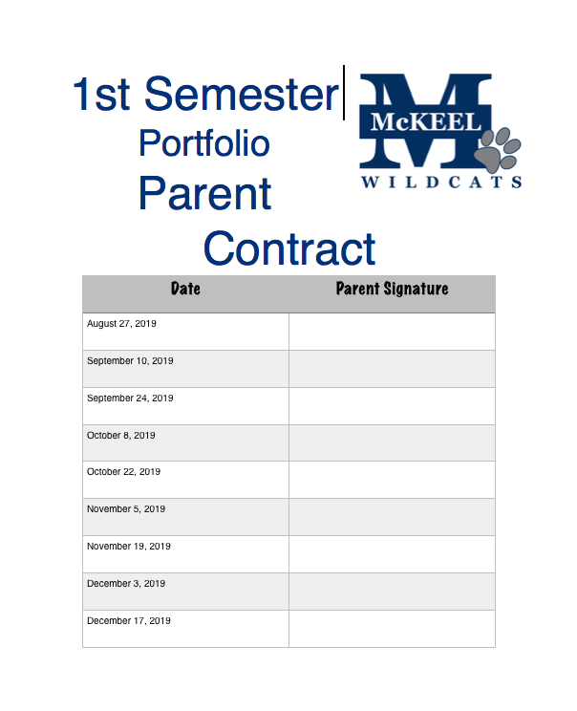
Grading System
We use a standards based grading system in grades K-6th.
Student Portfolios will be sent home every two weeks beginning Aug. 27th. Please sign and return the portfolio as it comes home.
Please remember that a level 4 does not mean a grade of A. The levels of 4,3,2,1 are a student’s level of performance for a specific skill within the 9 weeks.

Slide 5
Canvas and SeeSaw
We will be using Canvas and SeeSaw as our online platform for classwork assignments, activities, and formatives.
Most summative test will be administered on paper.
Please sign up for Seesaw with the QR code sent home at orientation.

Slide 6
At Home Practice
At Home Practice: Read for 20 minutes and study spelling words as needed. (Spelling City)
Math: Will be written in the agenda; please review the assignment with your child. Continue to study Multiplication and Division Fluency
Other practice will be assigned as needed.
Page 3 of the agenda

Slide 7
Behavior
The Student Contract is located on page 4 of the agenda.
Classrooms may earn Paw- Print Parties. When classes get caught being good they earn a Paw Print. The classroom teacher will track the rewards in class. Once 25 Paw-Prints have been earned a celebration will take place. (Let your child’s teacher know if you would like to help donate to the Paw- Print celebrations).
Teachers may also have their own positive behavior system that they use in the classroom (Ex: Class DoJo points or tickets).
Grade Level Wide: Students could receive Incident reports (warning), Minor Infractions (repeated offense), Major Infractions.
Infractions and Office Referrals will be sent to you electronically. Look for “Paw-sitive” Behavior Referrals, which will also be sent electronically.

Slide 8
Communication
Agendas
Email
Phone Calls
Seesaw
Conferences
Class Dojo
Page 4 of the agenda

Slide 9
Dress Code
Students need to obey the dress code each day, including wearing a belt if bottoms have belt loops.
Jackets must be solid navy blue, and please write the child’s name on the tag.
Long sleeved shirts worn under polos must be solid white or gray.
Legging colors are solid white, black, or gray.
Jeans must be plain and free of rips.
Pages 5 and 6 of the agenda

Slide 10
Birthdays
McKeel Academy Central will recognize student birthdays on a weekly basis at school.
Please do not send in food or invitations for celebrations.
Page 2 of the agenda.

Slide 11
Reading
Reading with your child and asking questions about what they are reading will help your child grow in language arts.
Please refer to the class website or DoJo messages for the skills we are working on for that week. You may use the websites provided on our webpage for additional practice. We use Moby Max, Readworks, and Spelling City. Login information is in your child’s agenda.
AR goals and levels will be inside the agendas.

Slide 12
AR Goals
AR goals will be set by the language arts teacher (Mrs. Bailey or Mrs. Testerman).
Students will be aware of their AR goal. It will be listed in each students agenda each grading period as well.
You can sign up for home connect to see emails when your child takes an AR test.
Students can earn a school-wide AR reward each 9 weeks The deadline for the first AR goal is Oct. 11th.

Slide 13
Writing
Writing is a major focus this year.
Writing is a complex skill and takes time to develop.
As we send samples home, please talk to your child about their writing. Encourage them to grow and continue working, even when it gets difficult.

Slide 14
Social Studies
We will be diving into Florida history this year.
We will need parent volunteers for several social studies class activities throughout the year. More information will be provided at a later date.
Students will be knowledgeable and excited to go to St. Augustine after they have learned about the rich history that occurred there.

Slide 15
Math
The biggest thing you can do at home to help your child be successful in 4th grade math is to work with them on multiplication and division facts. The curriculum revolves around multiplication and division.
Some of the resources we will use this year include: Zearn, Moby Max, and Prodigy.

Slide 16
Science
Science involves many inquiry based hands-on activities.
Students will have to complete an independent science fair project this year. The project will begin in January, and students will have approximately 6 weeks to complete it with weekly progress checks with the teacher.

Slide 17
Music
Mrs. Cunningham will be offering several enrichment clubs this year including caracal as well as band. A form went home last week, but we have a few extra copies available for anyone who may need it.
Recorders are available for purchase from Mrs. Cunningham.

Slide 18
Field Trips
Circle B Bar Reserve
October 10th for Dougherty and Bailey
October 11th for Taylor and Testerman
Chaperones are not allowed per Circle B Guidelines
St. Augustine- Date is TBA. The cost is approximately $75 total for adults.
Semester Dues are $25 and will cover the cost of our fall field trips and student field trip shirts. Parent shirts are $10 and can be paid online, cash, or check. Please mark your child’s shirt size size tonight on the slip provided and turn it in before you leave. Online dues and parent t-shirt orders close on August 30^{th.}
Volunteer forms are online. The deadline for all applications is Sept. 13^{th.}
Chaperone criteria is located on page 5 of the agenda.

Slide 19
4th Grade Website
www.mac4th.weebly.com
Ms. Dougherty and Mrs. Bailey have a class website filled with useful links to the most commonly uses resources in 4th grade.
This is your one stop shop for videos about how to help your child succeed with skills they might need a little extra help on.
Students are familiar with the website and will use it to access Spelling City, Zearn, and assignments when they absent.
This is a great place to check out if your child is sick and needs to stay home but you want them to continue working on class skills and assignments to avoid getting behind.

Slide 20
Fundraisers
Once a month 4th grade will sell Pom Pom Pens in the gym for $1. We are in need of BIC pens and colorful yarn for our fundraiser. Thank you for your donations.
Fall -Otis Spunkmeyer Cookie Dough (Oct. 21st – Nov. 4th)
Winter- Krispy Kreme Donut Certificates. (January)
PTO Fundraisers
Aug. 22nd Pelican Spirit Night 6-9
Aug. 26th Walk A Thon Kickoff

Slide 21
Volunteer And PTO
Volunteer applications are online this year. You can complete multiple applications for all family members by logging out and back into the dashboard on McKeel Office. The deadline for completing the application is September 13th and will not be extended.
We have opportunities for you to volunteer including: changing bulletin boards, helping with rotation days, and junior achievement. Please email your child’s homeroom teacher if you are interested in helping.
Also, we encourage you to join the PTO. It is only $5 per family. The PTO does many wonderful things for our school and our classrooms. There are also opportunities to volunteer with PTO.

